Slide 1


Programming Tote Stacker’s Conveylinx Board
By: CST Edgar Barba

Slide 2
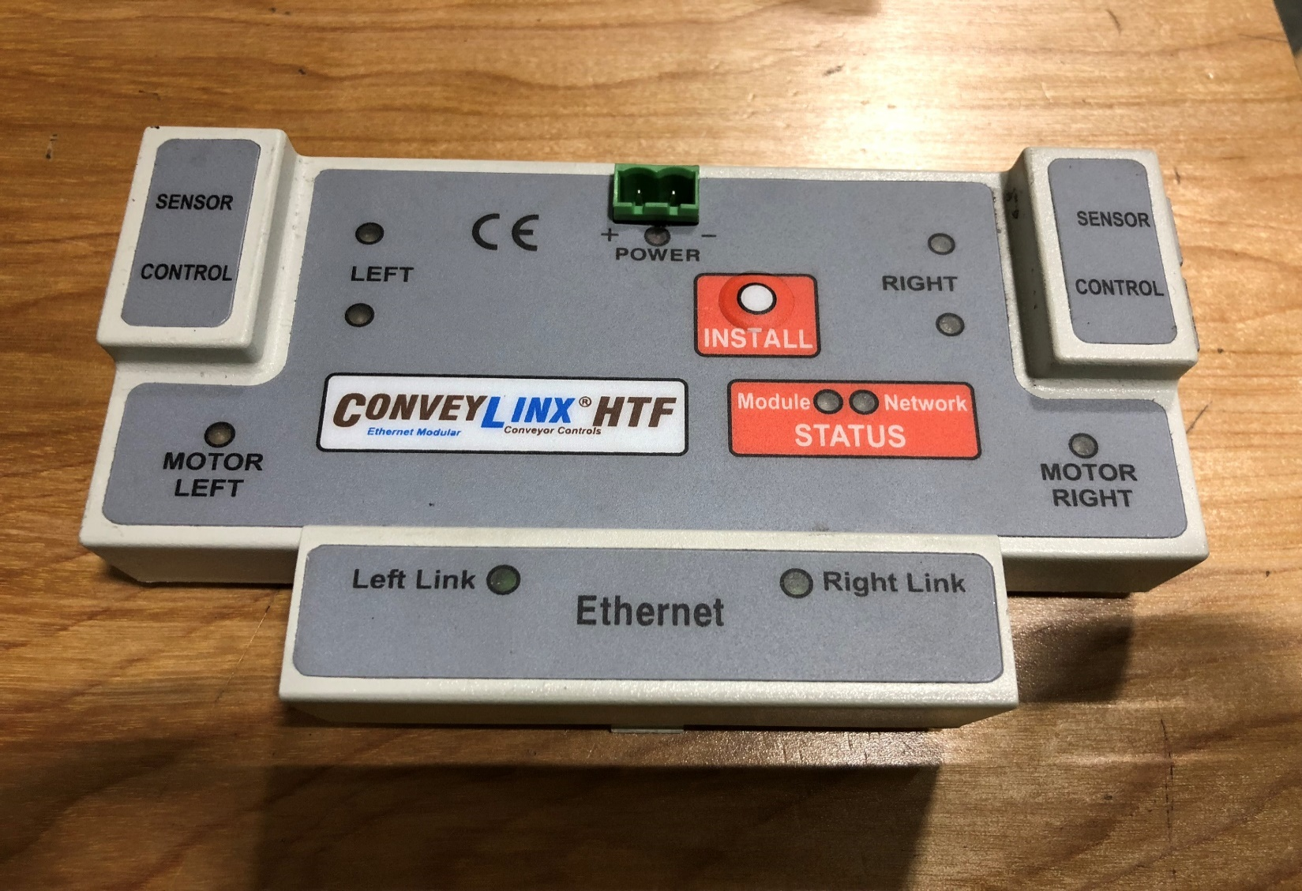
ConveyLinx Controller Board.

Slide 3
Step 1.
Before beginning the process, make sure to have the software needed installed in your computer.
Software needed is Easy Roll.
Link for software. https://www.pulseroller.com/controls/conveylinx/
After clicking the link. Scroll down and click on software.
Once you click software, the download file will pop up, click on Easy Roll V4 11. It should prompt you to download a zip file.
After you download the zip file you can go ahead and install the software. It is an easy install.
Once you have the software you are ready to begin the next step.
Link for manual. http://www.indsoft.bg/downloads/CL/ConveyLinx_Users_Guide_v4_4.pdf

Slide 4
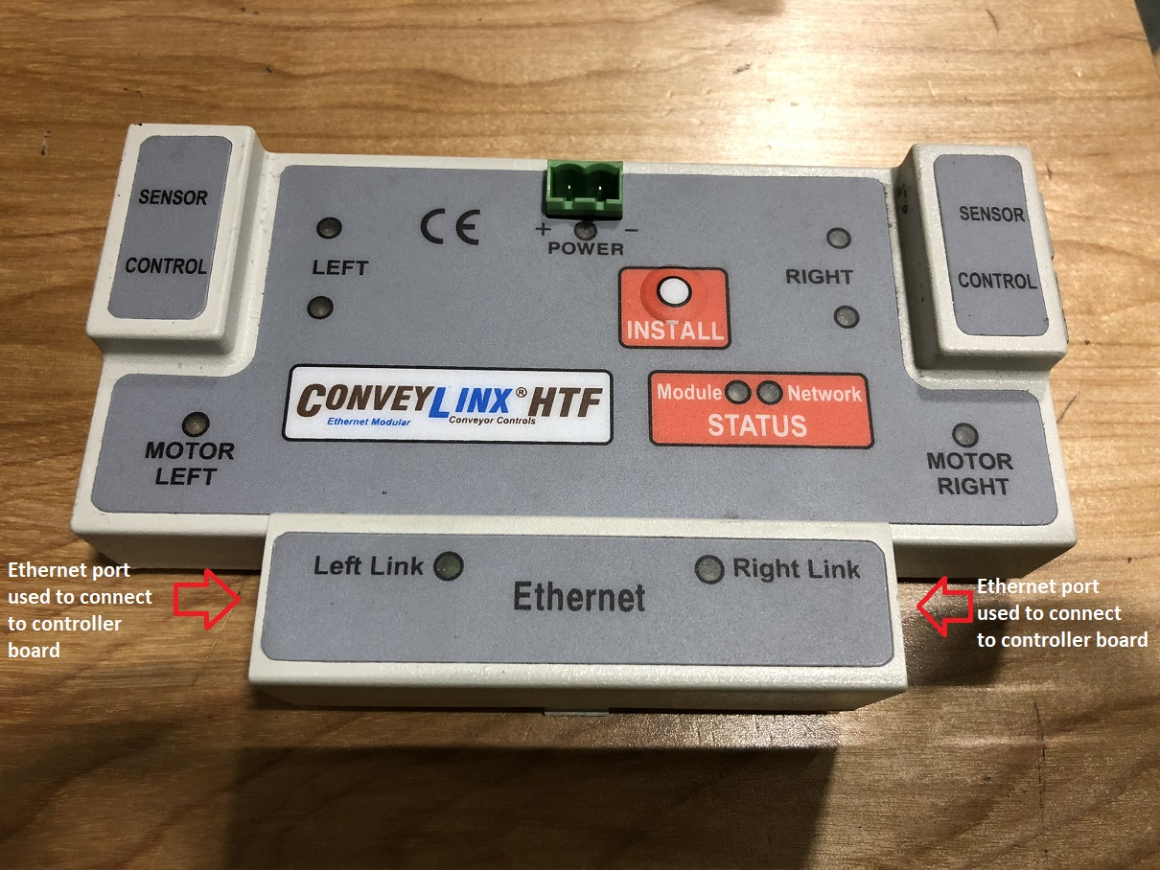
Make sure to have power on the board.
Use any of the indicated Ethernet ports to connect to the board.

Slide 5
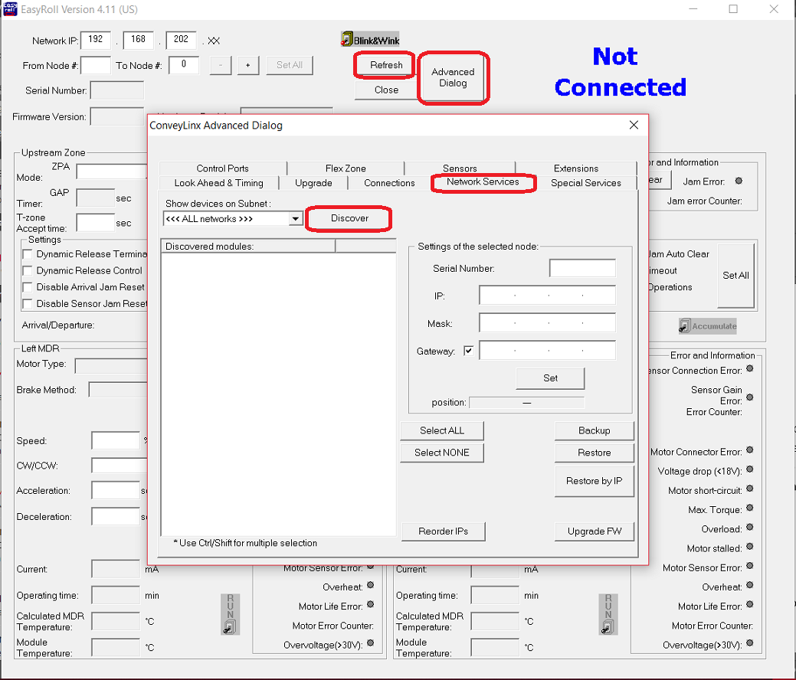
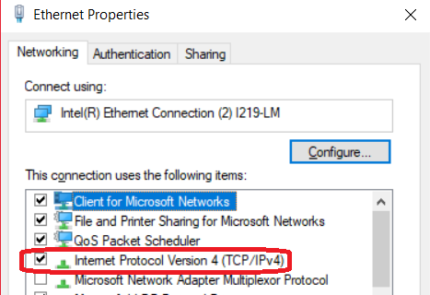
Step 2.
IP of board should appear here.
Start Easyroll and click on Advanced Dialog, then Network Services and click on the Discover button. The IP address of the card should be given. Write it down.
Set the Ethernet IP4 address of the laptop to an IP address in the same subnet. For example, if the card is 10.34.25.134, you could use 10.34.25.135.
Set the laptop’s Subnet to 255.255.255.0
Set the laptop’s Gateway to xxx.xxx.xxx.1 where xxx is the first three triplets of the card’s IP address.
You should now be able to connect to the card by clicking Refresh on the main page.

Slide 6
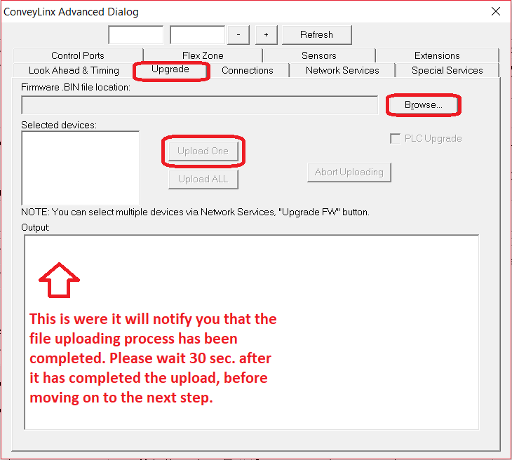
Step 3.
Once connected, click on Upgrade tab, browse to the location of the .bin file and select it.
Once file has been selected, click on upload one.
.bin file has been attached to email.
Once the file has uploaded, wait about a minute for the software to verify and complete installation. You will see an initial verification that the file is ‘complete’ but wait at least another 30 seconds just incase it also needs to upgrade the firmware (it does it automatically once you upload the .bin file).

Slide 7
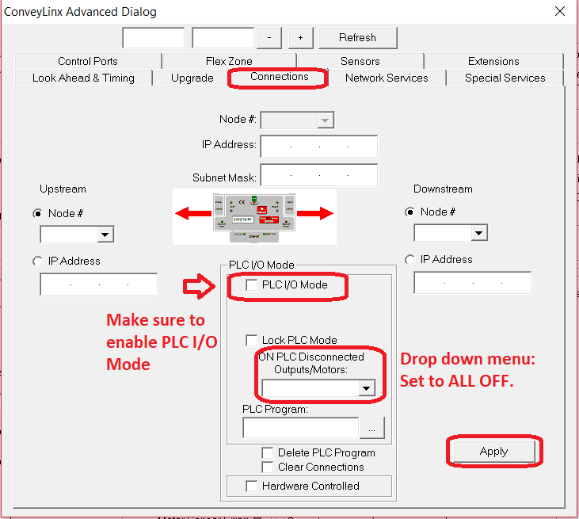
Step 4.
Go to Connections tab.
Check box for PLC I/O mode.
Drop down menu for PLC disconnected should be set to All OFF.
Click “Apply” and then cycle power so changes can take effect.
After the power cycle, Controller Board should be programmed and ready to go.

